Slide 1
HR ANALYTICS DASHBOARD

Slide 2
TABLE OF CONTENTS
Output of MS Excel Dashboard
Output of Tableau Dashboard
Output of PowerBi Dashboard

Slide 3
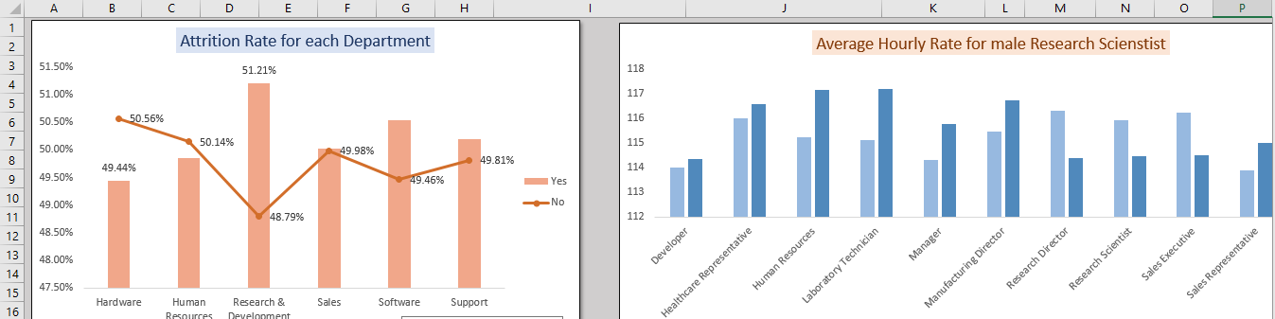
OUTPUTS:- MS EXCEL

Slide 4
Output: MS Excel

Slide 5
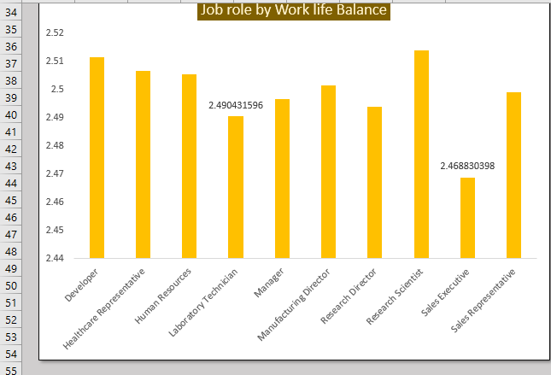

Slide 6
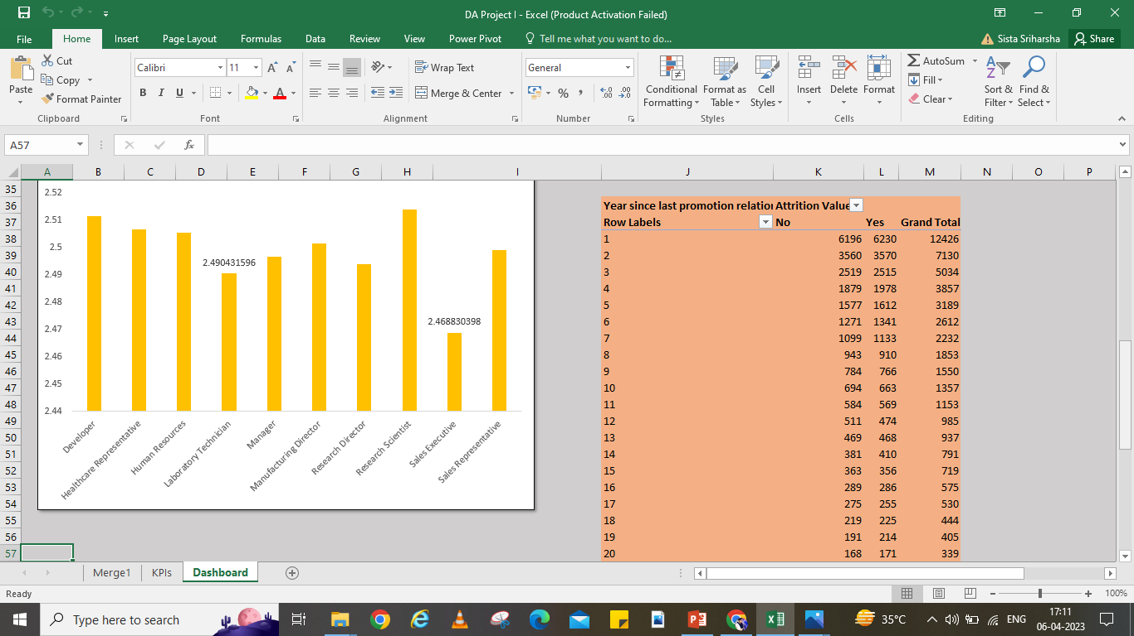
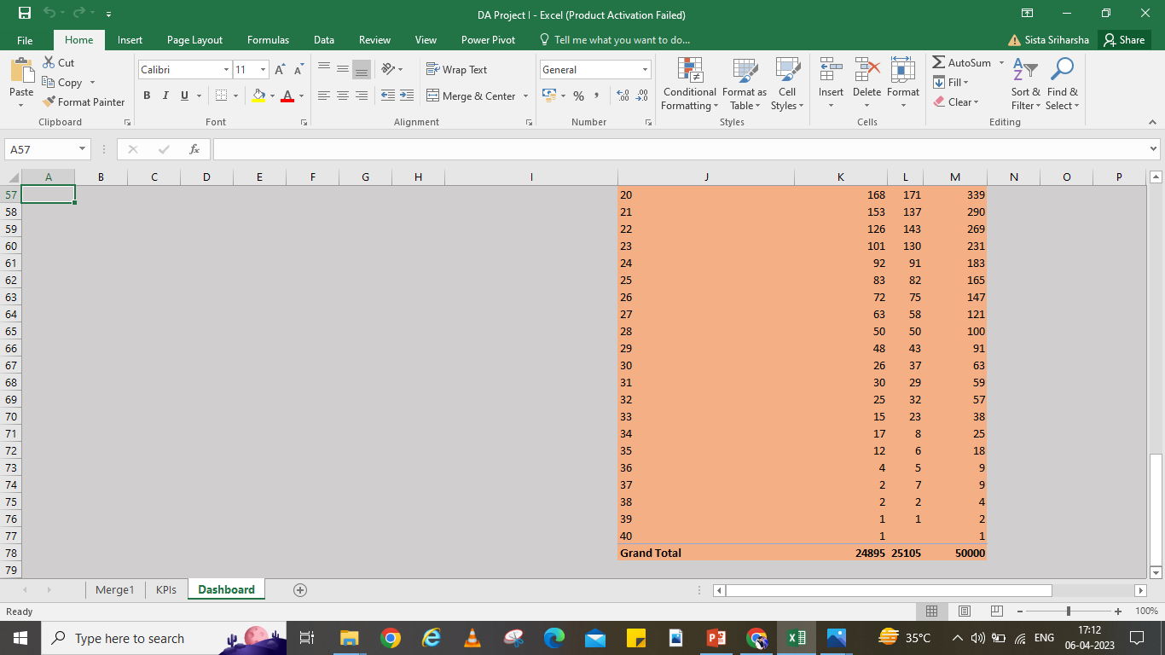

Slide 7
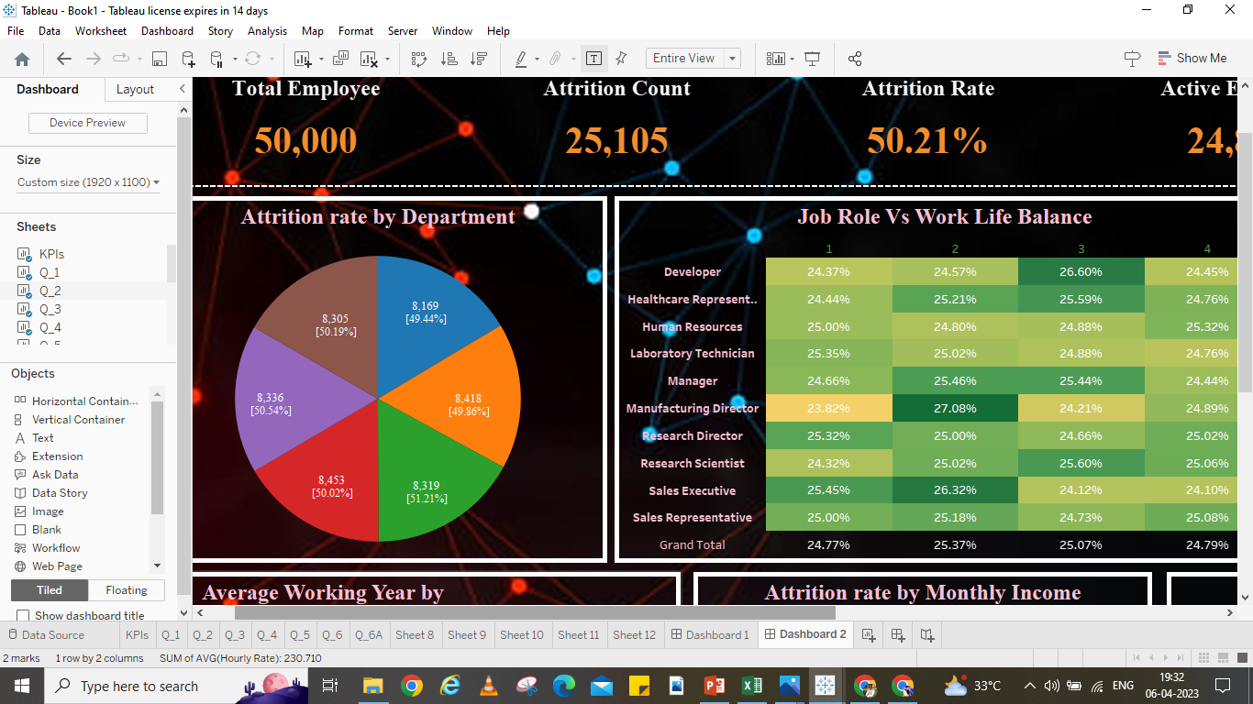
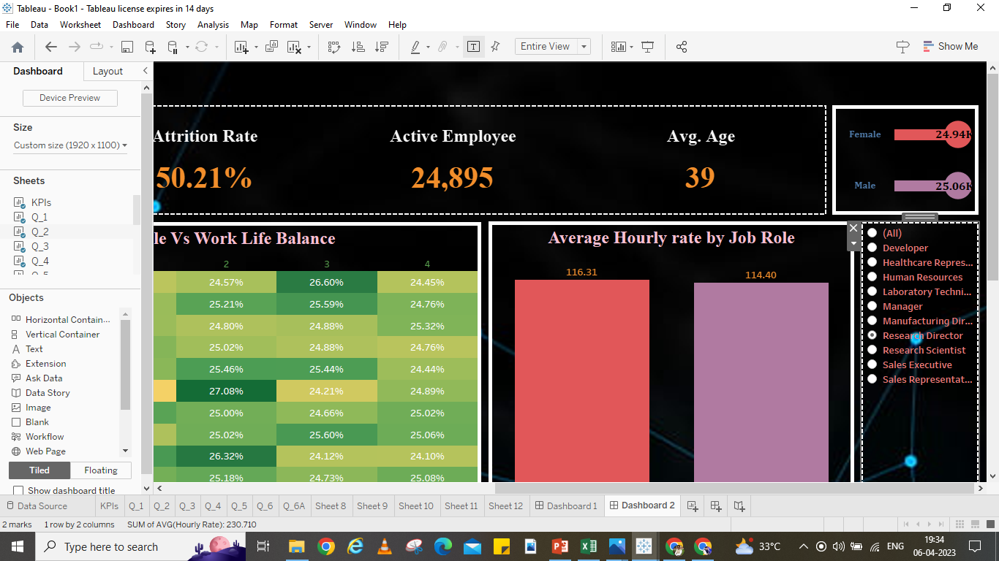
Output:- Tableau Dashboard

Slide 8
